Slide 1
Viewing output of Assignment 3 on Nexys4 board
Made use of constraints file to map pins from our code to FPGA pins
16-09-2019
TIFR-FCRIT

Slide 2
Steps-
We created a wrapper module in out code that creates a instances of all sub-modules. This file was named as top.v .
Added a constraints file that maps the input and output ports in our code to specific input and output pins on the Nexys4 FPGA board.
Used Adept 2 to burn the code on our FPGA.
Verified the output for various inputs.
16-09-2019
TIFR-FCRIT

Slide 3
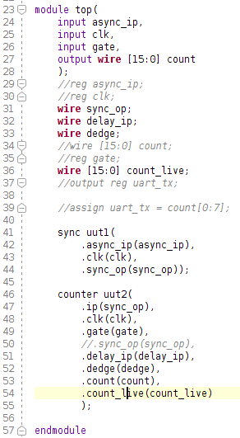
The wrapper module top.v-
This module has 3 inputs and one output in the form of a 16 bit vector.
It creates an instance of each independent module in the design.
16-09-2019
TIFR-FCRIT

Slide 4
The constraints file-
The constraints file in Vivado is used to map the ports of our code to the pins of the FPGA board. The format of the constraints file is .xdc.
Xilinx provides with a master file .xdc file for the Nexys4 board. We made use of this file and made changes according to our needs to map the ports.
16-09-2019
TIFR-FCRIT

Slide 5
Mapping done by us-
Input clk: Internal clock of 100 Mhz pin E3
Input gate: Switch pin L16
Output vector count 16 bit: LEDs pins H17-V11
For taking input using switch-
Input async_ip: Switch pin J15
For taking input using button-
Input async_ip: Button pin M17
16-09-2019
TIFR-FCRIT

Slide 6
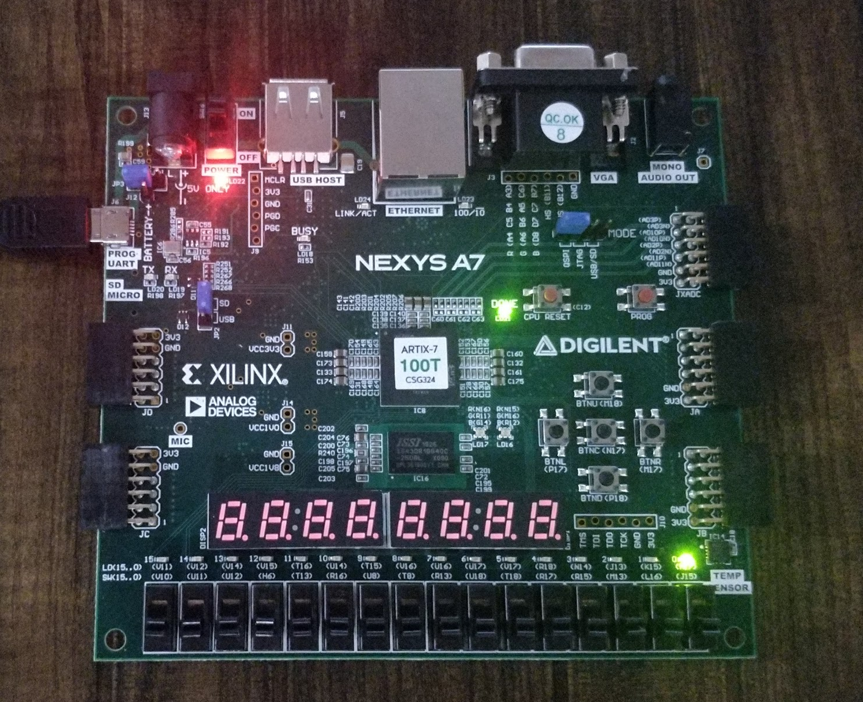
The output-
Input- button pressed 1 time
16-09-2019
TIFR-FCRIT

Slide 7
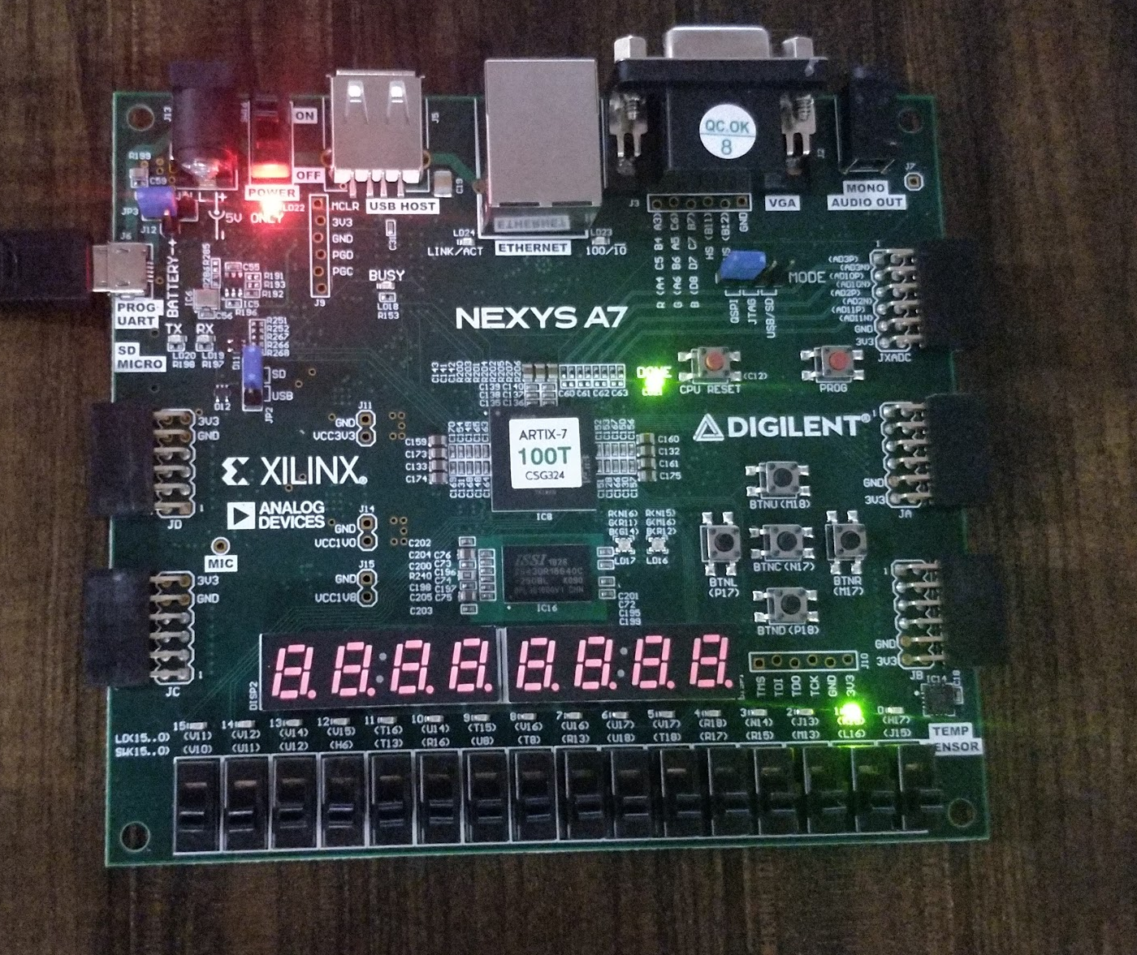
The output-
Input- Button pressed 2 times
16-09-2019
TIFR-FCRIT

Slide 8
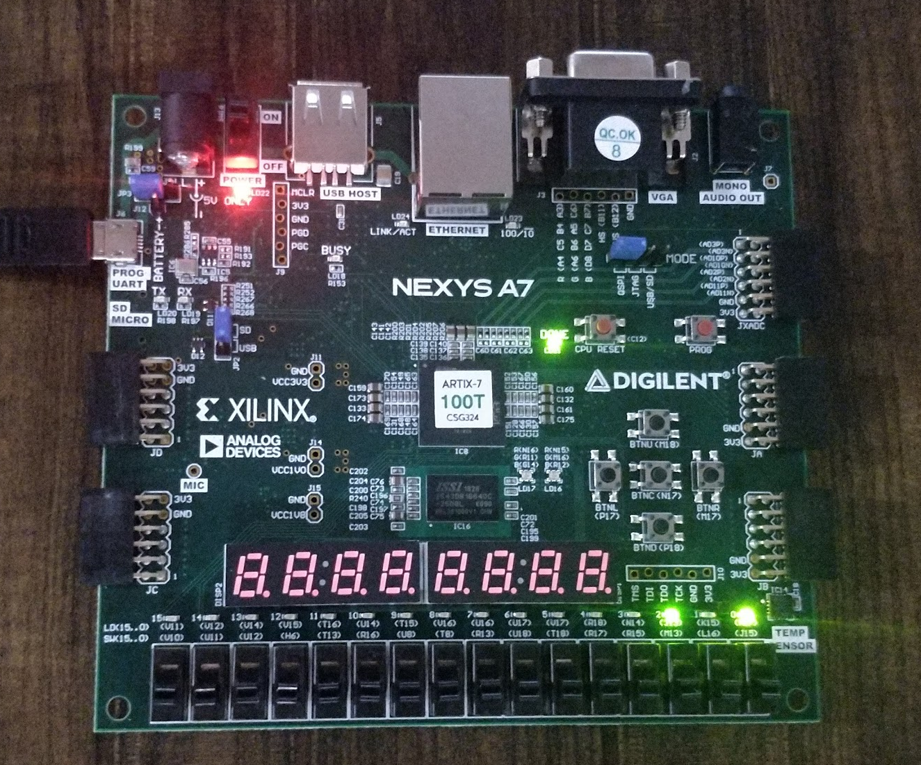
The output-
Input- button pressed 5 times
16-09-2019
TIFR-FCRIT

